Slide 1
Session 04
Module 8: Abstract classes and Interface
Module 9: Properties and Indexers

Slide 2
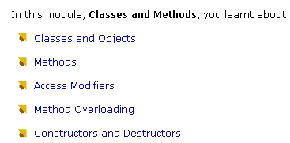
Module 6 - Review

Slide 3
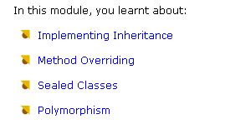
Module 7 - Review

Slide 4
Module 8 - Objectives
Describe how implement abstract classes
Define abstracts methods
Describe how implement interface
List the differences between abstract class and
Interface

Slide 5
Abstract Base Classes
Abstract classes are classes that can be inherited from
Abstract base classes cannot be instantiated nor can they be sealed
C# allows creation of Abstract Base classes by an addition of the abstract modifier to the class definition
An abstract method is defined in the abstract base class and its actual implementation is written in the derived class

Slide 6
Abstract Base Classes - Example
using System;
abstract class BaseClass
{
public abstract void MethodA();
public void MethodB()
{
Console.WriteLine ("This is the non abstract method”); }
}
class DerivedClass : BaseClass
{
public override void MethodA()
{
Console.WriteLine ("This is the abstract method overriden in derived class");
}
}

Slide 7
Abstract Base Classes - Example
class AbstractDemo
{
public static void Main()
{
DerivedClass objDerived = new
DerivedClass();
BaseClass objBase = objDerived;
objBase.MethodA();
objDerived.MethodB();
}
}

Slide 8
Interfaces
An interface is a pure abstract base class
It can contain only abstract methods and no method implementation
A class that implements a particular interface must implement the members listed by that interface
public interface IFile
{
int delFile();
void disFile();
}

Slide 9
Interfaces - Example
public interface IFile
{
int delFile();
void disFile();
}
public class MyFile : IFile
{
public int delFile()
{
System.Console.WriteLine ("DelFile Implementation!");
return(0);
}
public void disFile()
{
System.Console.WriteLine ("DisFile Implementation!");
}
}

Slide 10
Interfaces - Output
class InterfaceDemo
{
public static void Main()
{
MyFile objMyFile = new MyFile();
objMyFile.disFile();
int retValue = objMyFile.delFile();
}
}

Slide 11
Multiple Interfaces
C# allows multiple interface implementations
public interface IFileTwo
{
void applySecondInterface();
}

Slide 12
Multiple Interfaces - Example
public class MyFile : BaseforInterface, IFile, IFileTwo
{
public int delFile()
{
System.Console.WriteLine ("DelFile Implementation!");
return(0);
}
public void disFile()
{
System.Console.WriteLine ("DisFile Implementation!");
}
public void applySecondInterface()
{
System.Console.WriteLine ("ApplySecondInterface Implementation!");
}
}

Slide 13
Multiple Interfaces - Output
class MultipleInterfaces
{
public static void Main()
{
MyFile objMyFile = new MyFile();
objMyFile.disFile();
int retValue = objMyFile.delFile();
objMyFile.open();
objMyFile.applySecondInterface();
}
}

Slide 14
Explicit Interface (1)
Explicit interface implementation can be used when a method with the same name is available in 2 interfaces
public interface IFile
{
int delFile();
void disFile();
}
public interface IFileTwo
{
void applySecondInterface();
void disFile();
}

Slide 15
Explicit Interface (2)
public class MyFile : BaseforInterface, IFile, IFileTwo
{...
void IFile.disFile()
{
System.Console.WriteLine ("IFile Implementation of DisFile");
}
void IFileTwo.disFile()
{
System.Console.WriteLine ("IFileTwo Implementation
of DisFile");
}..
}

Slide 16
Interface Inheritance
New Interfaces can be created by combining together other interfaces
The syntax for this is similar to that used for inheritance, except that more than one interface can be merged to form a single interface.
interface IAllFile : IFile, IFileTwo
{
//More operations can be added if necessary
//(apart from that of IFile & IFileTwo)
}

Slide 17
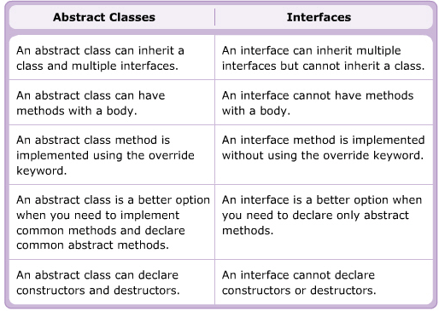
The differences between abstract classes and interface

Slide 18

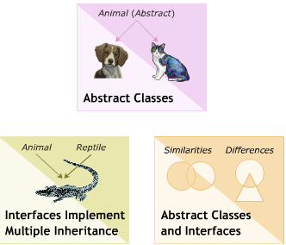
Module 8 - Summary

Slide 19
Module 9 - Objectives
Define properties in C#
List and explain the types of properties
State and explain indexers

Slide 20
Properties
Access modifier like public, private, protected, internal are used to control the accessibility of fields and methods in c#
The public field are accessible by other class but private fields are accessible only by the class in which they are declared
C# use feature called properties that allows you to set and retrieve value of fields declared with any access modifier in secured manner.

Slide 21

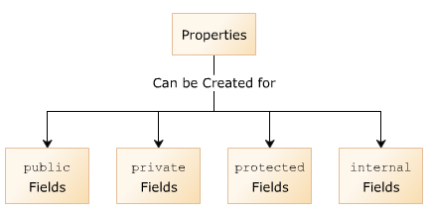
Syntax

Slide 22
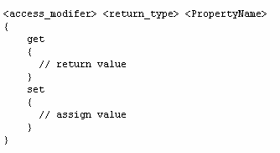
Properties
The get accessor is used to read a value
The set accessor is use to assign a value

Slide 23

Read only property
To retrieve the value of a private field
Need define the get accessor

Slide 24
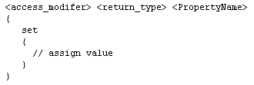
Write only property
To change the value of a private field
Need define the set accessor

Slide 25
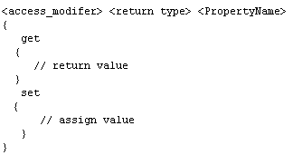
Read and Write property
To allow set and retrieve the value of private field
Need define set and get accessor

Slide 26
Use of properties
Modifies private field
Validates private field
Perform required actions
Implements abstraction
Implements encapsulation

Slide 27
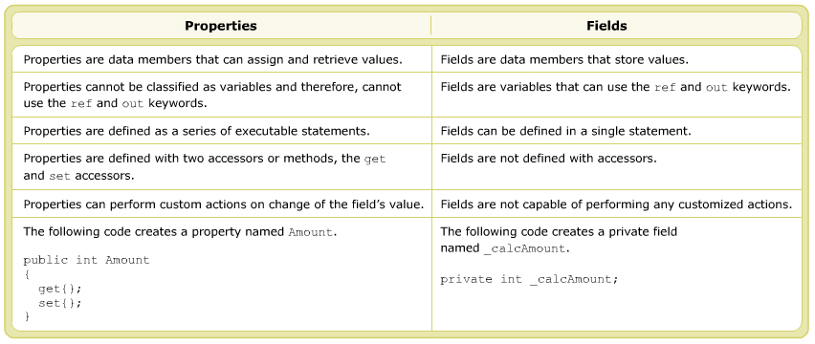
Properties vs. Fields

Slide 28
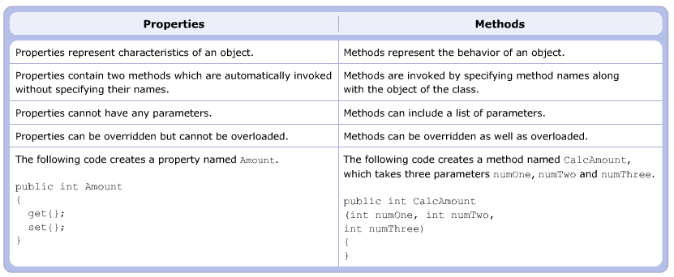
Property vs. Method

Slide 29
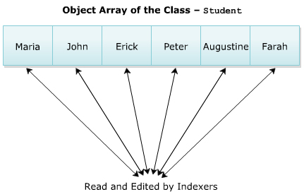
Indexers
Indexers are data members that allow you to access data within objects in a way that is similar to accessing arrays

Slide 30
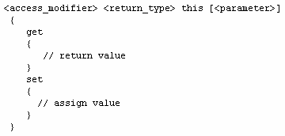
Syntax of index declaration

Slide 31
Parameters
Indexers must have at least one parameter.
The parameter denotes the index. position, using index position the stored value at that position is set or accessed.
Index can also have multiple parameters. Such indexers can be accessed like a multi dimensional array.

Slide 32
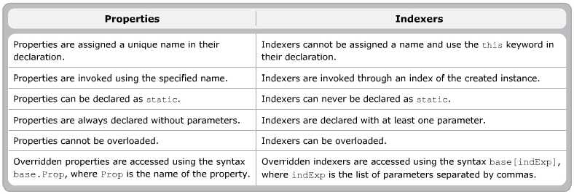
Properties versus Indexers

Slide 33
Module 9 – Summary (1)
A field is a data member of class that store some information.
Properties enables to you to access the private fields of class.
Methods are data members that define a behavior performed by an object.
Properties protect fields of the class while accessing them.

Slide 34
Module 9 - Summary (2)
Property accessor enable you to read and assign values to fields
Property can be created by using get and set accessors
Indexers treats an object like an array, so providing faster access to data within the object.

